Slide 1
Customer Analysis

Slide 2
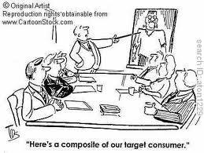
Building Blocks of Marketing
Segmentation
From this the target market is selected
Positioning
Defined by customers and is the place the product occupies in consumers’ minds
These form the foundation for your marketing mix

Slide 3
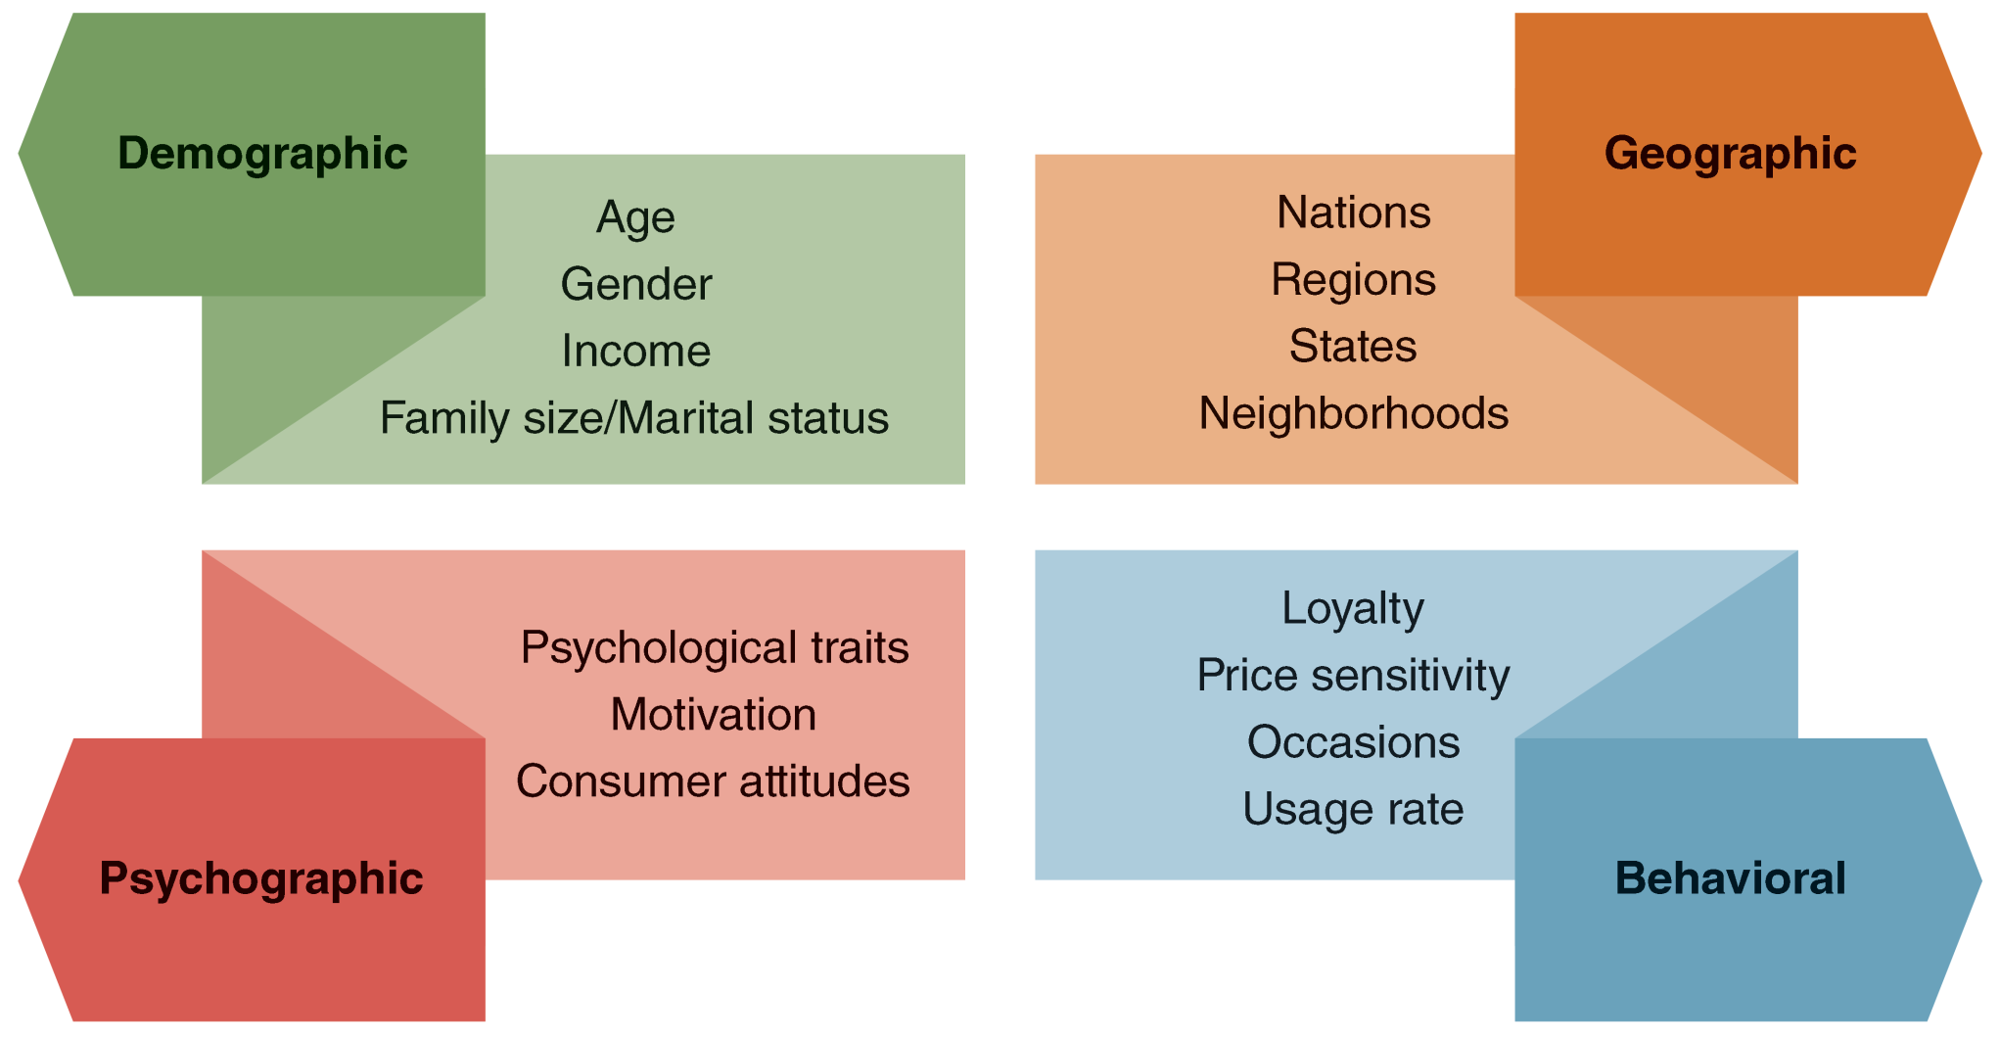
Four Bases of Segmentation

Slide 4
Customers
Need to understand customer needs
Utilitarian and hedonic
Direct and indirect
Also consider the process of making the purchase decision
Problem recognition
Search for information
Analysis of alternatives
Decision
After purchase evaluation
Source: Steenburgh & Avery (2010)

Slide 5
Customers
Other considerations
Describing the customer
How do we identify them?
Demographics, geographic, psychographic
Product usage
Who is involved in the purchase decision
One vs. many
Use of the product
Actual purchase - #, other products, purchase situation
Product consumption – amount consumed, consumption situation
Post consumption

Slide 6
Customers
Other considerations
Purchase motivation
Product’s competitive advantage
Nature of the relationship (transaction vs. relational)
Change in future needs
Reasons they would not purchase
Channels of distribution
Retailers where product is purchased
Trends within the industry
Time of purchase
Firm can drive sales with communication and promotion mix
External considerations such as seasonality and competition

Slide 7
Buyer personas
Provides a sketch of the different segments of your market.
You should give each persona a name and include specifics of:
Demographics
Motivations/Lifestyles
Needs/Attributes Desired
Challenges and how you address those
Marketing Message
Elevator Pitch
Influences in the decision-making process
https://socialamyw.files.wordpress.com/2016/03/buyerpersona4.jpg?w=665&h=507

Slide 8
Example from Healthcare

Slide 9
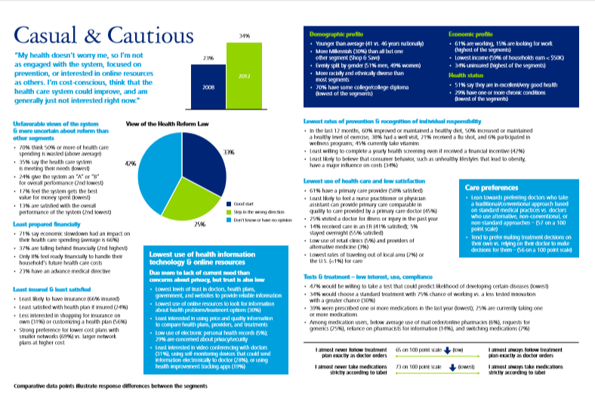

Slide 10
https://blog.alexa.com/wp-content/uploads/2017/10/B2B-Buyer-Persona-Example.png

Slide 11
Evaluation and Selection of Target Market
Size
Estimate potential sales volume within each potential segment
Growth
Segments that are growing are attractive
Level of competition
Capabilities match with the needs of the market

Slide 12
Selecting the Target Market
Clearly define:
Who is the target market?
What are their needs?
How can we identify them?
What are their purchasing habits and preferences?
How is the product consumed?

Slide 13
Market Positioning
In order to determine market positioning, you must consider
Distinctive competence
Sustainable competitive advantage
Once you determine positioning then you can tackle the other marketing elements
Dynamic process

Slide 14
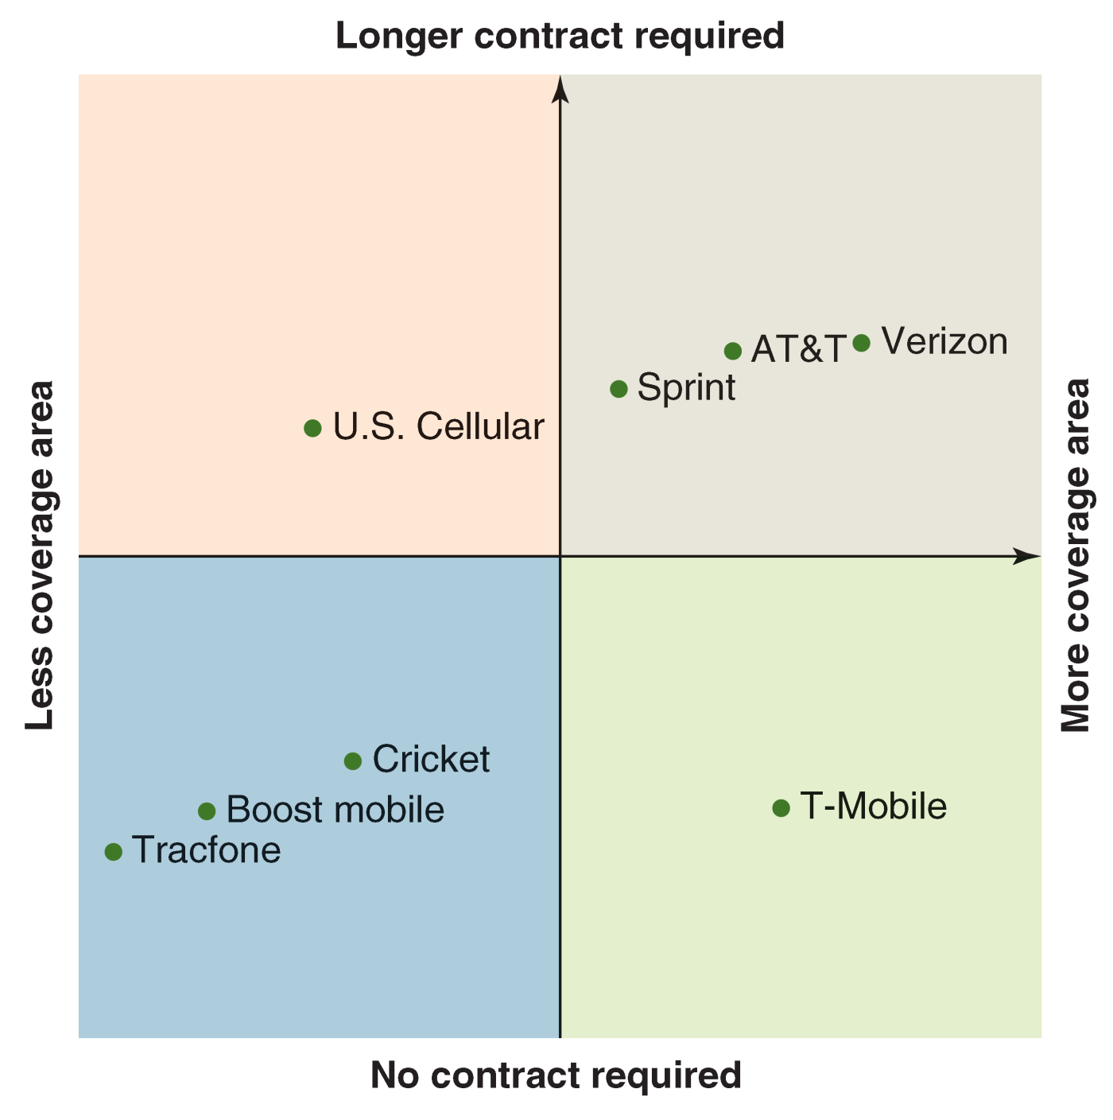

Slide 15
Positioning
Firms must develop a positioning statement
Customers will buy our product over competitor’s because: _______________________________
Think about the most compelling reasons
Should demonstrate why the firm’s offering is different!

